Slide 1

Project Overview: Forest Fire Detection

Slide 2
Forest Fires: Key Facts and Importance of Detection
Forest fires are uncontrolled blazes that occur in wildland areas, often ignited by natural causes like lightning or human activities such as unattended campfires and discarded cigarettes.
Devastating Damage
Environmental Impact
These fires can cause devastating damage to ecosystems, threaten wildlife habitats, destroy property, and put human lives at risk.
Additionally, they release significant amounts of carbon dioxide and harmful pollutants, contributing to climate change and air quality issues.
Early detection of forest fires is crucial because it allows for rapid response and containment, reducing the spread of fire, minimizing environmental and economic losses, and enhancing public safety. Timely detection helps preserve forest health and protect communities nearby.

Slide 3
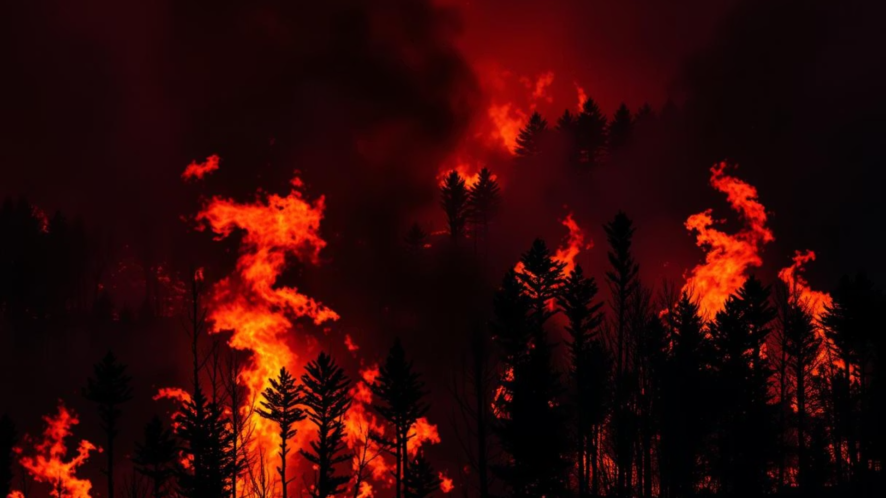



Dataset and Image Preprocessing
Kaggle Dataset
Preprocessing Steps
Image data featuring various forest fire scenes.
Resized images to 224x224 pixels
Converted colors to HSV space
The dataset consists of two classes: fire and no fire.
Applied Gaussian blur for noise reduction
Normalized pixels to range [0, 1]

Slide 4
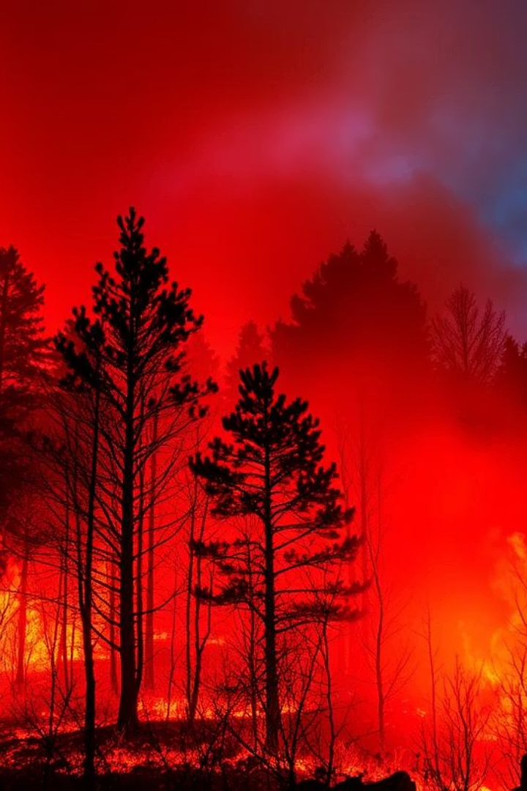
Model : Transfer Learning with ResNet18
Pre-trained ResNet18
Convolutional & Custom Layers
Uses a pre-trained ResNet18 model as a starting point. This speeds up training and enhances accuracy with fewer labeled examples.
The model's convolutional layers extract general image features. Custom layers are fine-tuned for forest fire detection.
Pattern Recognition
This method leverages learned patterns like edges and textures, adapting them to identify fire characteristics.

Slide 5
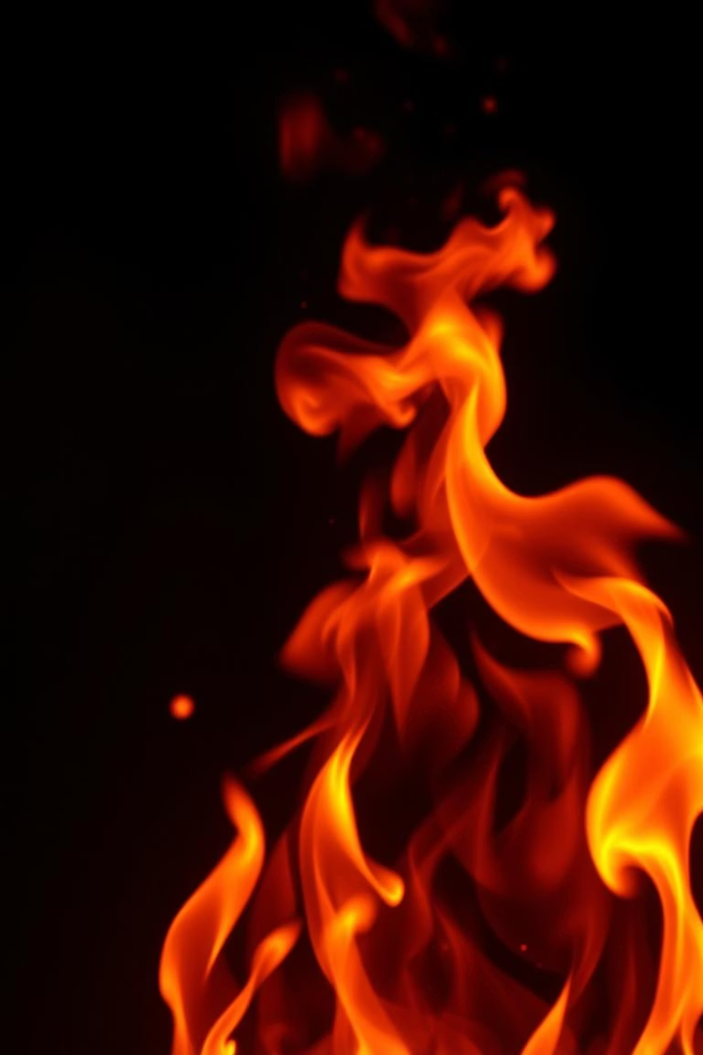




Model Training : ResNet18 Fine-Tuning
Final Layer Adaptation
Replaced ResNet18’s classifier with a 2-class output layer for fire detection.
Loss Function
Used CrossEntropyLoss to optimize classification between fire and no fire.
Optimizer & Learning Rate
Adam optimizer with a low learning rate of 0.0001 speeds stable convergence.
Training Duration
Model trained over 10 epochs balancing performance and resource use.

Slide 6

Web Application with Streamlit
User Interaction
Real-time Display
Deployment
Upload images to detect fire quickly using the trained ResNet18 model.
Instant results shown on the web app interface created using the ML model.
Hosted on Streamlit Cloud for easy and accessible use.

Slide 7
Summary and Next Steps
Achievements
Next Steps
Successful fire detection model
Expand dataset with satellite and edge data
Accessible web app for real-time use
Improve model with weather and environment data

